Slide 1
Pipe and Relationship Fitting
Steve Seiler and Scott Sandwith

Slide 2
Relationship Fitting Basics
Measure Features then associate to Nominal Features in Relationships
Each measured/nominal pair is saved in at least one relationship
Decide what moves and what remains fixed
Generally move the “measured” to the “nominal”
Define tolerances, sampling, constraints and options
Tolerance, nominal angle/distance between, keep outside/inside, sub sample options, outlier rejection, weight, etc.
Optimize Alignment - Relationships
Solve simultaneously or piecewise
Report Results

Slide 3
Part 1: Alignment with Relationships

Slide 4
Demo 1: Plant a Tree
Goal: Put the base of the tree in the existing hole. Align the trunk to be normal to the ground.
Arbor Day is Friday, April 28th 2017

Slide 5
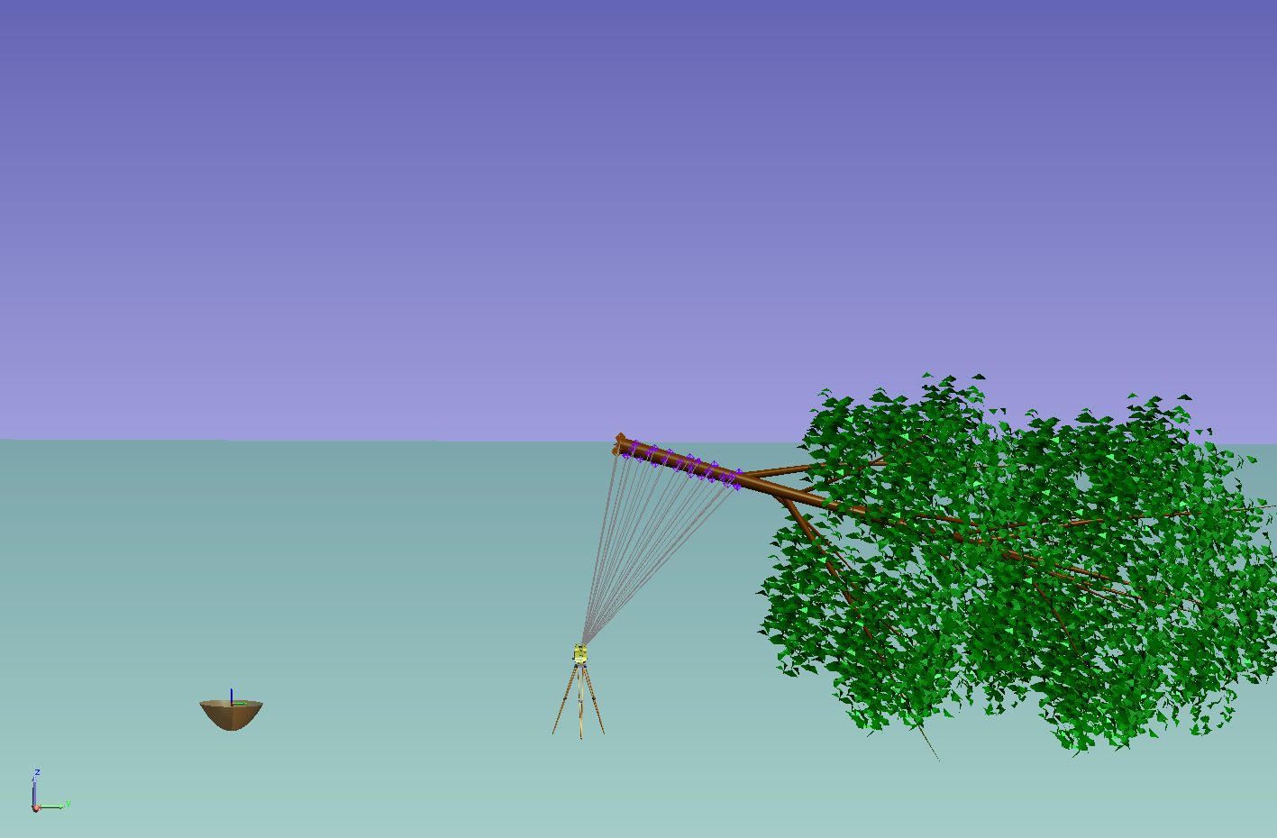
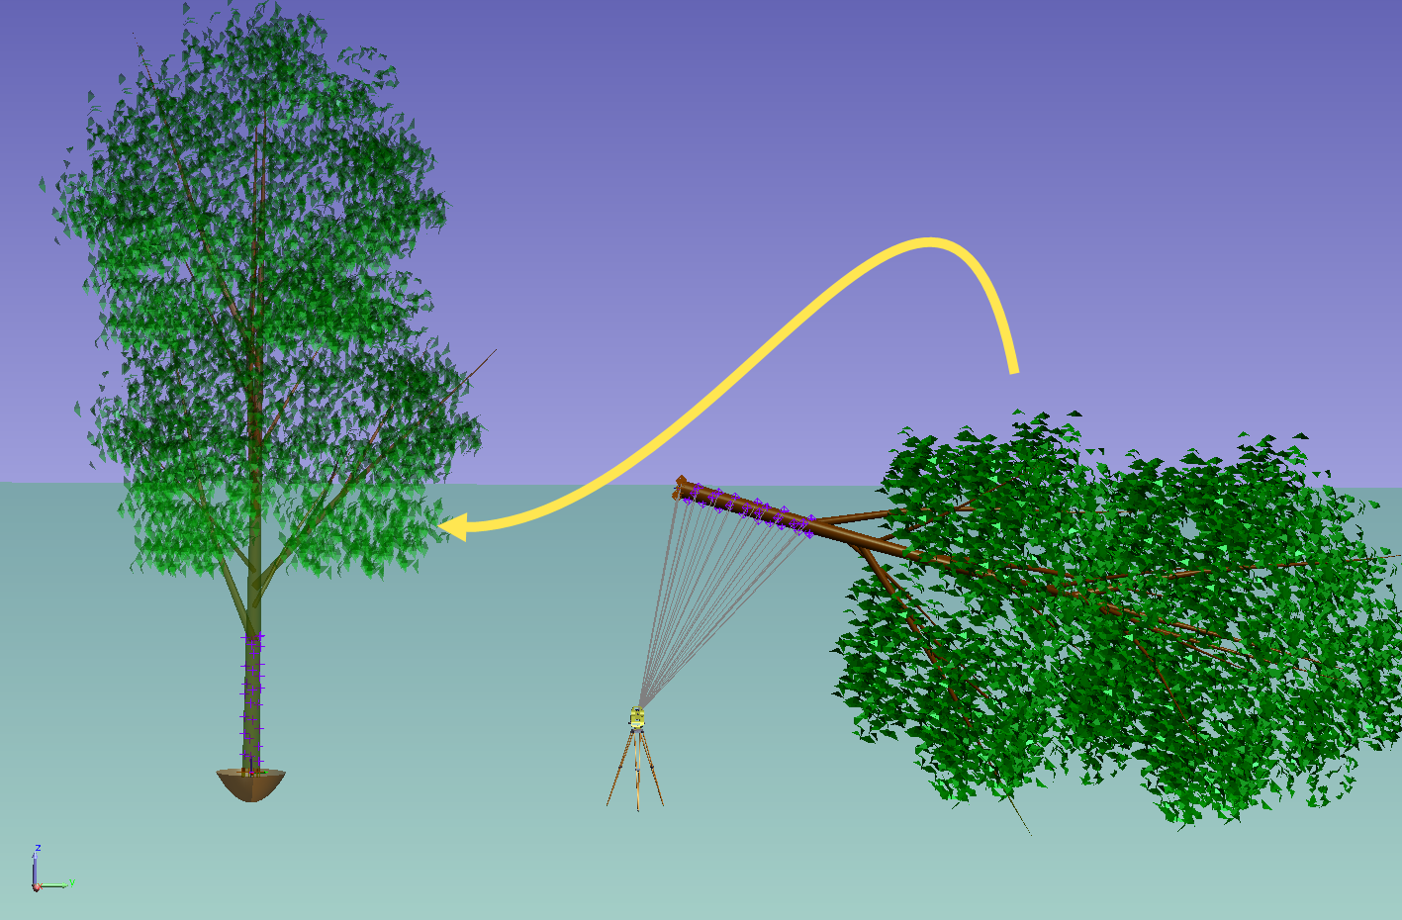
Plant a Tree

Slide 6
Two Relationships
Relationship: Point to Object
Tree Base Circle Center to
“Hole at Surface” Frame
Minimize

Slide 7
Two Relationships
Relationship: Object to Object Direction
Trunk Cylinder to
“Ground” plane normal
Minimize

Slide 8
Part 2: Virtual Fit & Predictive Shimming

Slide 9
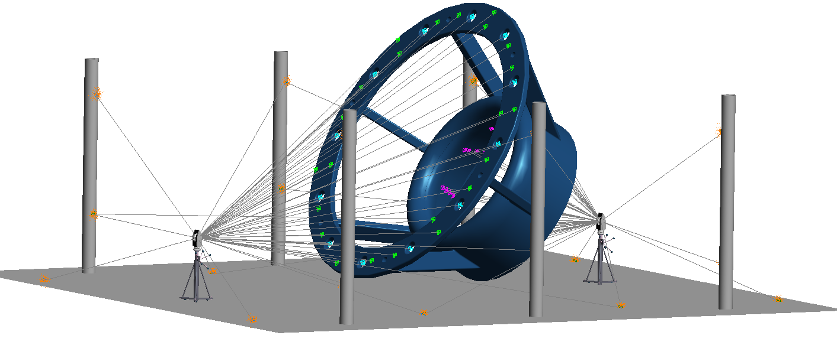
Demo 2: Virtual Fit & Predictive Shimming
Base Survey
Scenario:
Two large parts were measured independently. They will be assembled together.
Goals:
Align the two components such that
Axis of the “Top Inner Cone” and “Base Cylinder” are in line and parallel.
Mating surfaces are as close together as possible without intersecting
Bolt Holes line up.
Top Survey

Slide 10
Process
Import separate inspection files into the same SA file
Create Geometry
Top Cone
Base Cylinder
Base Plane
Create relationships
Solve relationships in sequence

Slide 11
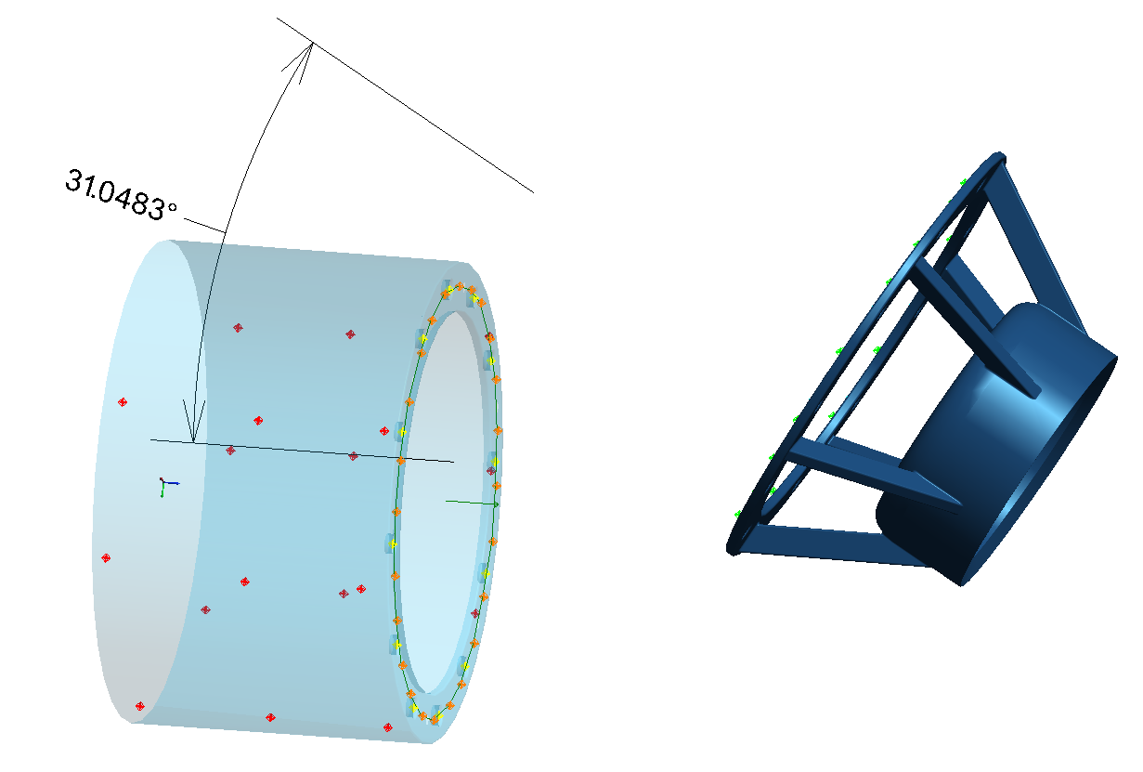
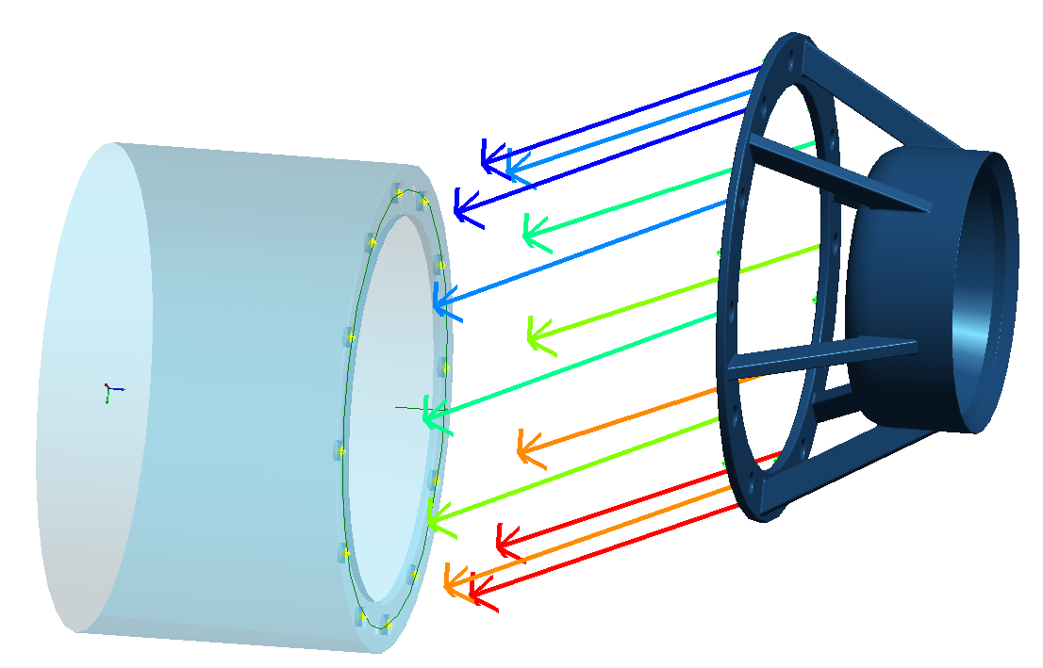
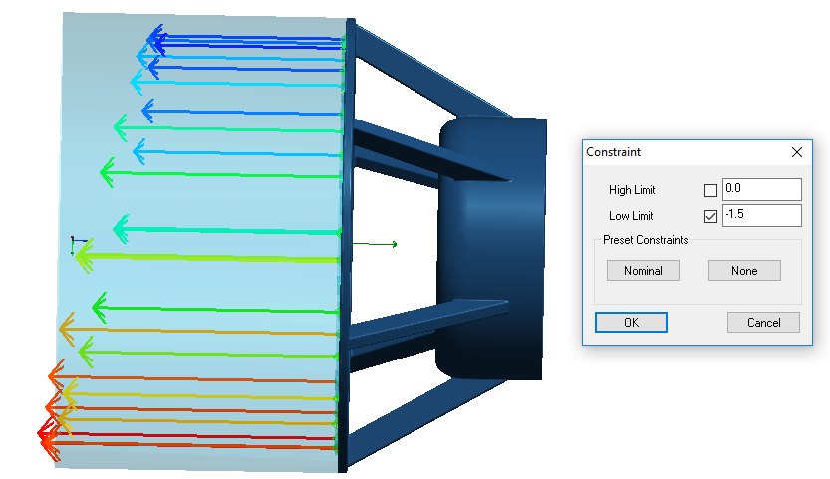
Process
Create relationships
Object to Object Direction
Top Cone/Base Cylinder
Group to Group
Top Bolt Hole Centers/Base Bolt Hole Centers
Points to Objects
Top Mating Points/Base Mating Plane
Make a working frame relative to fixed object.
Solve relationships in sequence
Minimize
Minimize
Minimize

Slide 12
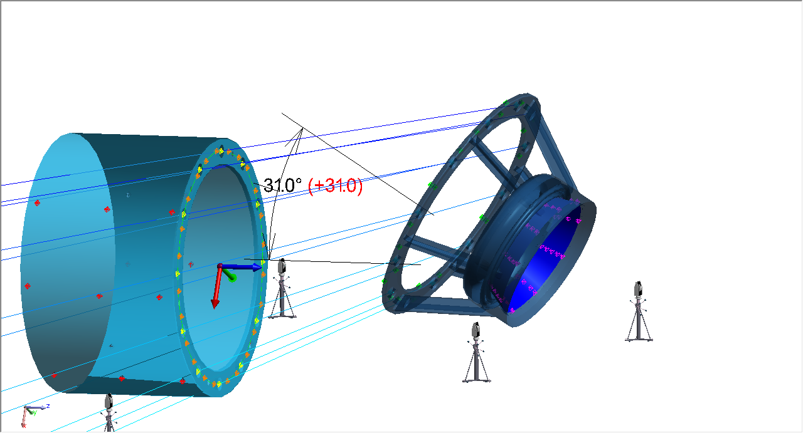
Virtual Alignment
Starting Position

Slide 13
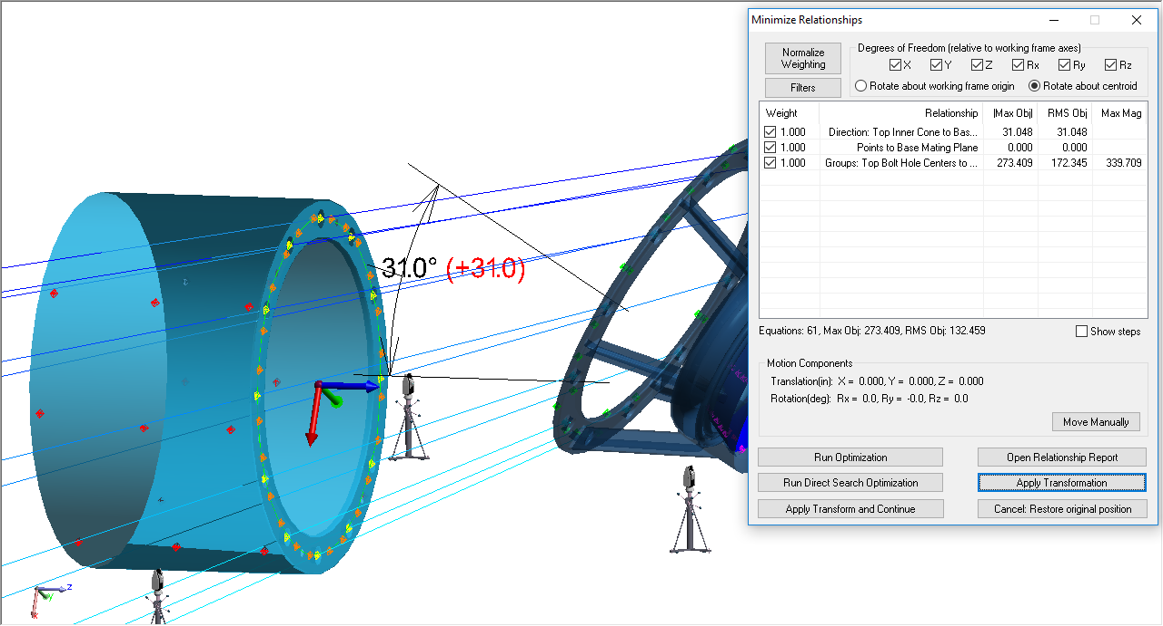
Virtual Alignment
Starting Position

Slide 14
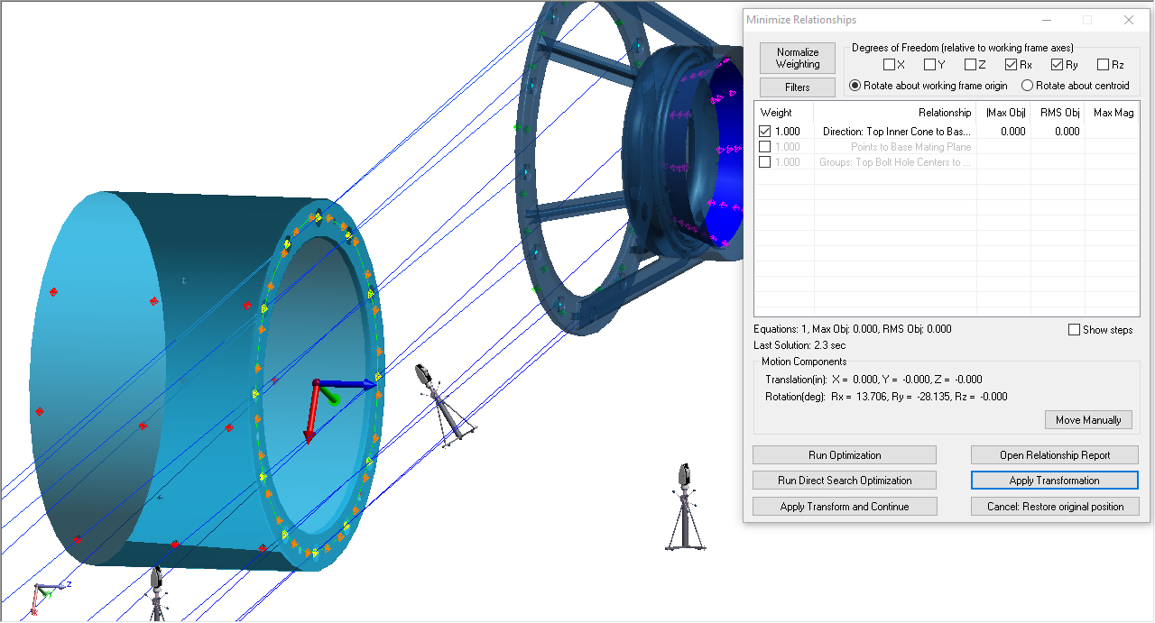
Virtual Alignment
Cone/Cylinder Direction for
Rx, Ry

Slide 15
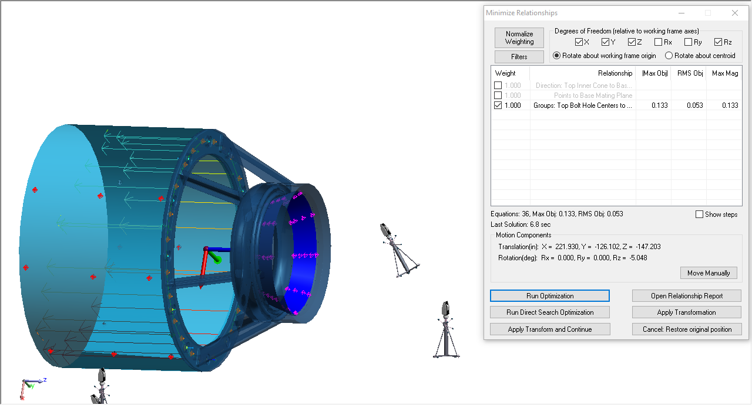
Virtual Alignment
Bolt Hole Group to Group for
X, Y, Z, Rz

Slide 16
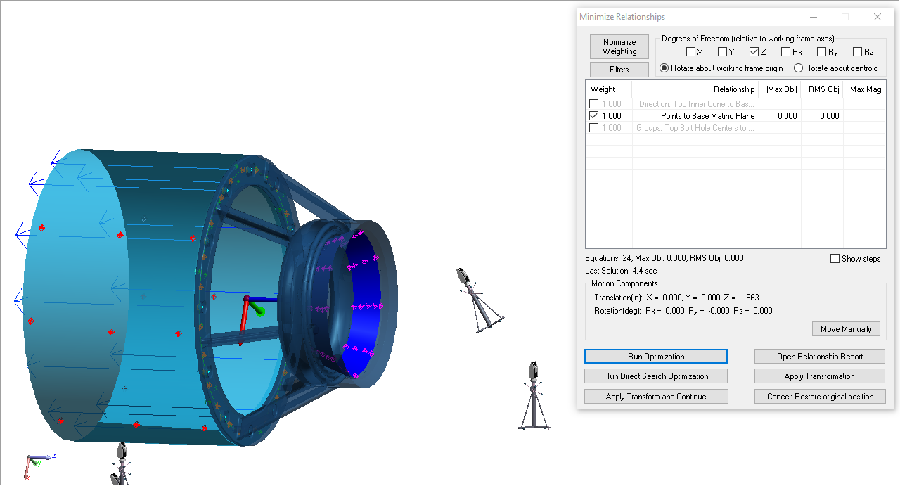
Virtual Alignment
Top Points to Base Plane for
Z
Notes:
The bolt hole centers relationship brought the top and base too close together (the points defining the holes had some depth). This starting condition is critical to allow the fit constraint to work on the Top Points to Base Plane relationship. If the top points were already outside of the 1.5” of the base plane, there would need to be another relationship to drive the top as close as possible to the base in Z.

Slide 17
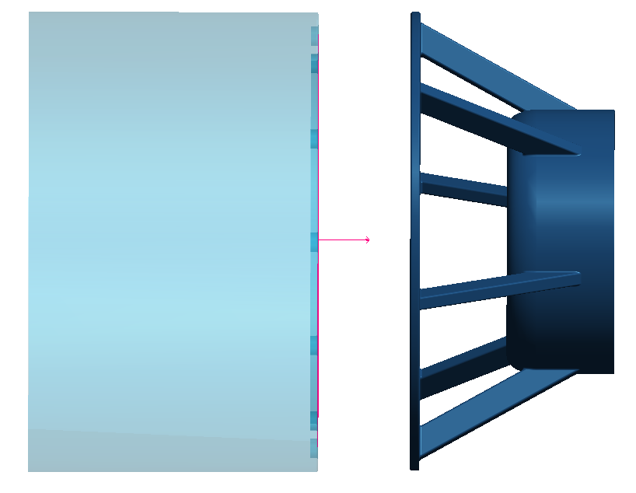
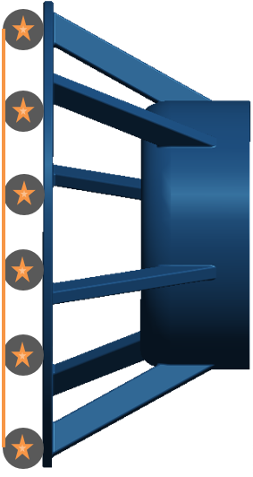
-1.5” fit constraint?
Fit Constraint
SMR Diameter = 1.5”
Probe Centers
Assumed Contact Point
(shift against plane normal direction)
Top Mating Points (enlarged)
Fit Constraint: Minimum 1.5” inside of Base Plane.
Anything from -1.5” from the plane and greater is OK
Keep Out!
Safe Zone
Notes:
SA guesses the point of contact by shifting from the probe center against the object normal by the probe radius. Since this assumption is not valid for this situation, we can override by saying that all points can only go as far as 1.5” “into” the surface

Slide 18
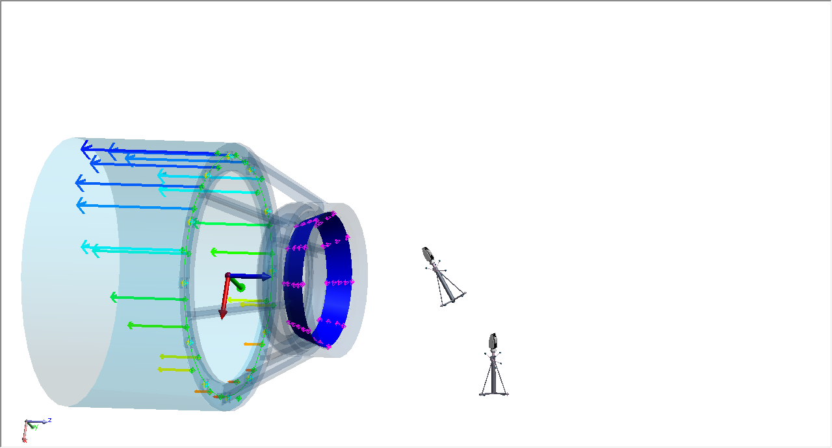
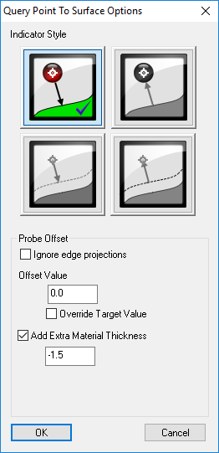
Virtual Alignment
Copy Points to Plane Relationship
Remove 1.5” fit constraint
Turn on auto-vectors (add “extra” material)

Slide 19
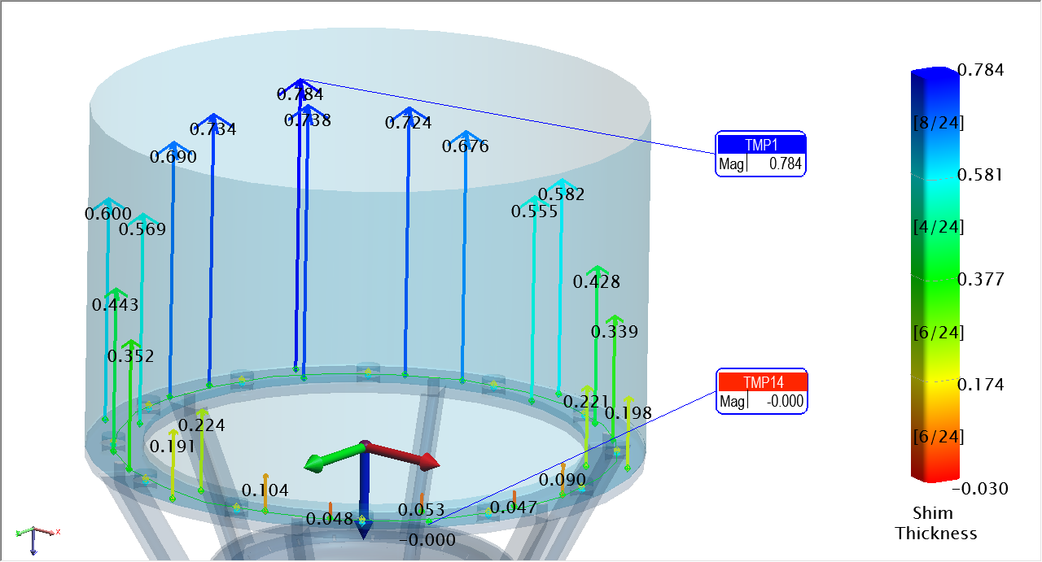
Report Shim Thicknesses

Slide 20
Relationships = Value
Relationships capture the distances or orientation between measurements and objects
Collections of objects (describe common relationships) → Part Features
EASY TO USE
Directly Optimize Part Features → Best Performance
Transform Features and Instruments to Parts with Relationships (Feature to Feature BEST-FIT)
* Enhanced Reference System

Slide 21
Benefits of Relationship Fitting
Optimize product performance
Relationship between features are optimized directly! → Build / Inspect / Report → Repeat
Cost savings and flow time reduction
Set/Inspect/Report/Repeat part features directly from CAD
Reduces measurement tolerance guess work
Improves assembly reliability
Custom configurations directly on the shop floor
Integrate assembly configuration for design/tolerance improvements

Slide 22
Part 3: Pipe Relationships

Slide 23
Why
Pre-plan where/how to cut each pipe
Save time ($) during install
React to unplanned cuts, use measurements as input
Apply pipe-specific constraints
Solve a pipe network simultaneously with many constraints and influencing parameters (traditional Relationships + Pipe Relationships)

Slide 24
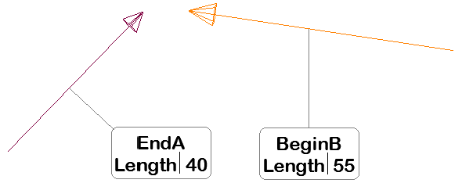
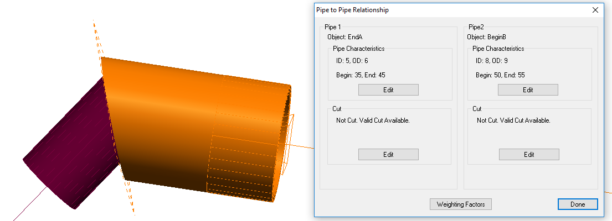
How
Define a relationship at an intersection where two pipes will join.
Each mating end uses an object (line, circle, cylinder, plane, etc.) to define the axis and direction of the pipe
The two objects should point toward the location of the cut
Define ID/OD of the two pipes

Slide 25
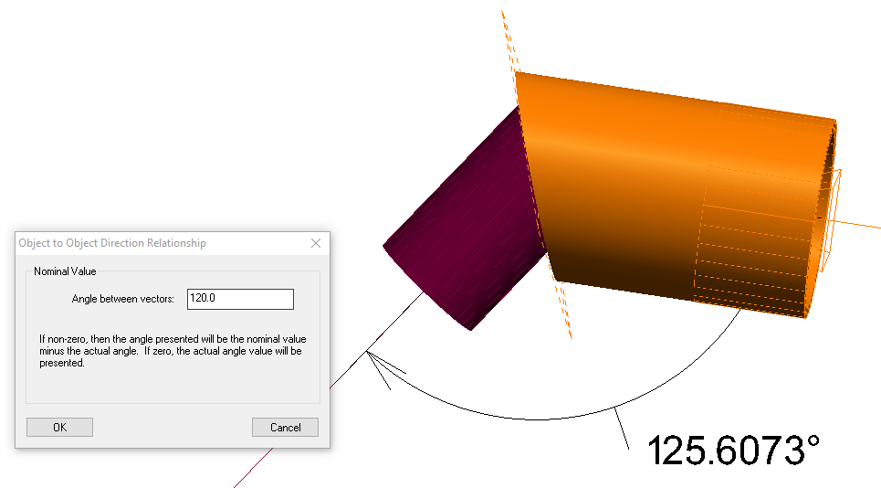
How
Define additional constraints

Slide 26
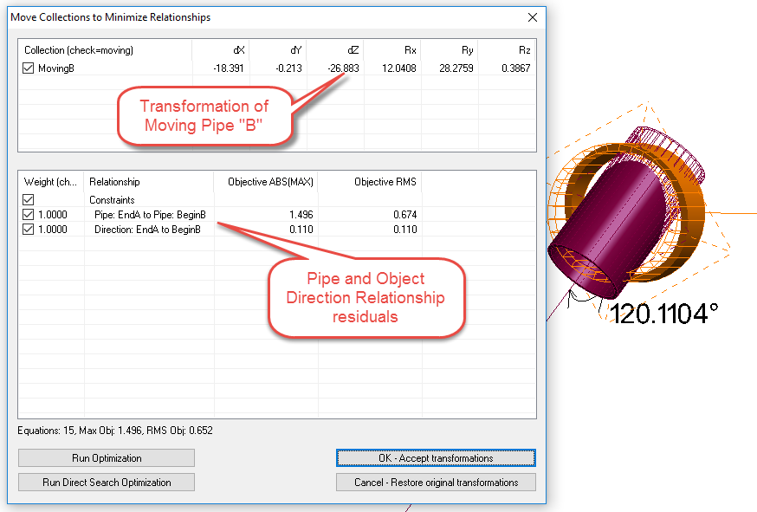
How
Solve Relationship Optimization

Slide 27
How
Allowable Cut Region
Allowable Cut Region

Slide 28
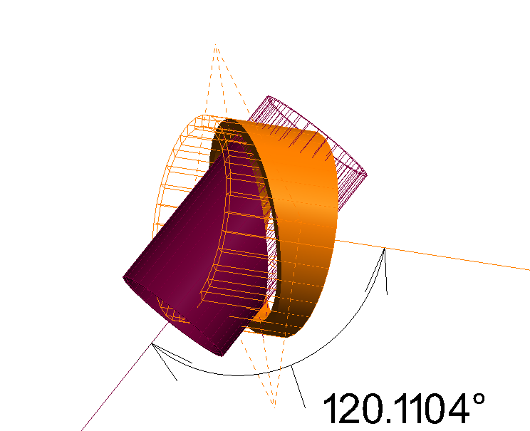
How
Proposed Cut
(dashed plane)

Slide 29
How
Remaining
Pipe
Cut
Pipe

Slide 30
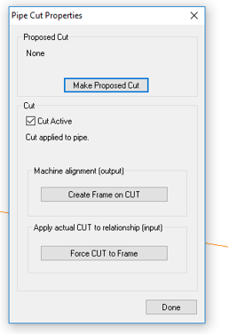
How
Make Proposed Cut(s)

Slide 31
How
To layout the proposed cut plane on the actual pipe:
“Create Frame on CUT”
Layout points or scribe a line using a watch window on this frame
Once the pipe is actually cut
Remeasure the end of the pipe
Define a Frame based on the pipe center and end plane
“Force CUT to Frame”
Re-run optimization with the “as cut” pipe end.
Solve for the necessary cut plane of the mating end.

Slide 32
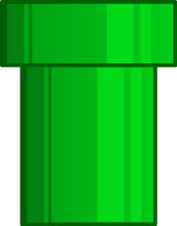
Constraints
Center Pull:
The importance of overlapping the center of each pipe segment’s cut region (along the axis direction). Larger values assign more importance
Axis Alignment:
The importance of minimizing the angle between the two pipe segments. Larger values will force the pipe segments to be more parallel.
Axis Offset:
The importance of minimizing the mutual perpendicular midpoint between the two pipe segments (i.e. how “coaxial” the two pipe segments are). Larger values attempt to bring the segments closer together.

Slide 33
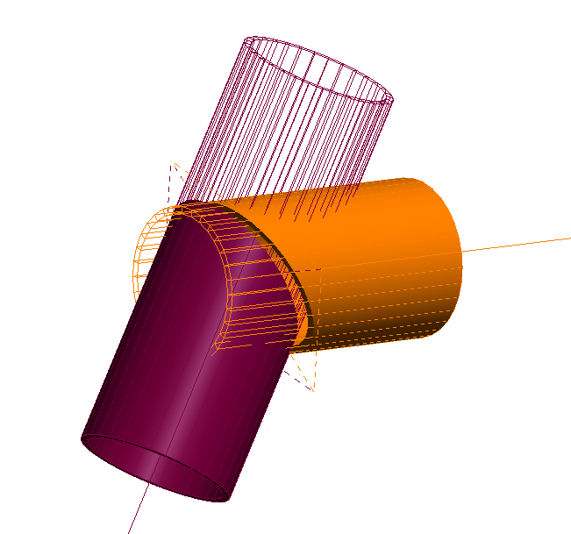
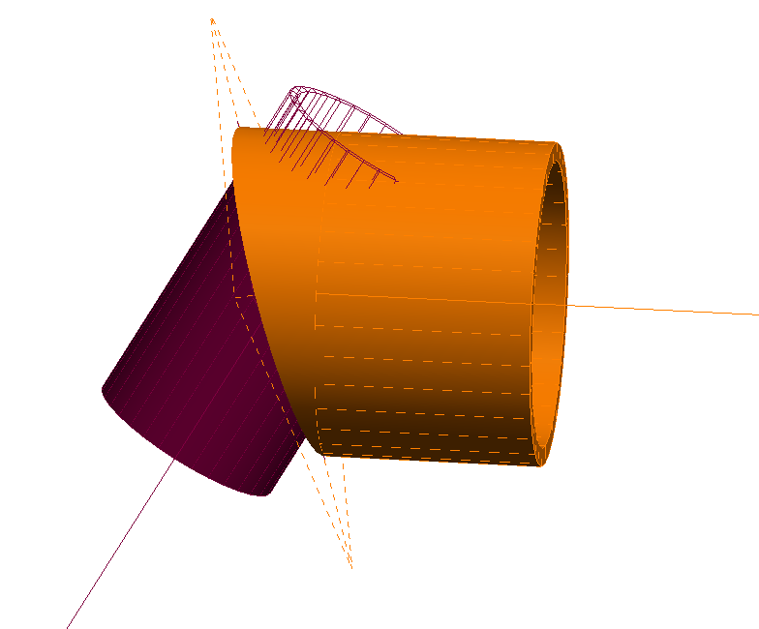
Constraints
Constrain Cut to Region at OD:
If checked, ensures that the cut angle at the outer diameter does not cause the cut plane to exceed the defined region. If unchecked, this restriction is ignored.
Constrain Cut so ID/OD Overlap:
If enabled, the inner diameter/outer diameter values for the pipes are used to ensure that
there is sufficient material based on the angle of alignment.
Weight:
The importance of having sufficient material for the weld. A value of zero implies that the solution does not care if there is sufficient material for the weld.
Static Offset:
A value that controls “how bad” the solution gets when there is insufficient material for the weld. Higher values assign a larger penalty to having insufficient material, effectively ensuring that material requirement is more crucial in the eyes of the solution.
Gap
Allowable Cut Region

Slide 34
Demo 3: Pipe Relationships
Goal:
Connect the 3 fixed couplings using:
1 “T” coupling
1 “45” coupling
4 Straight Pipes
Straight 45C
Straight AT

Slide 35
Demo

Slide 36
Pipe Relationship Tips
If both ends of a pipe need cut, define each end with its own object.
The object type used to build the Pipe Relationship doesn’t matter as long as position and orientation are defined
The direction of the objects used in the pipe relationship should both point to the cut plane (intersection)
Once a solution is found, the rendered pipe will be solid where material remains, and wireframe where material was removed. If the cut happened on the wrong side, flip the orientation of the defining object.
If a valid cut plane isn’t found but seems to be possible, try changing the OD/ID values of one pipe end so that it doesn’t exactly match the mating pipe, or uncheck “Constrain Cut so ID/OD Overlap”
Isolate each independently moving entity in its own collection. During optimization, use “Move Collections by Minimizing Relationships”.

Slide 37
Questions?

