Slide 1
SA/Inspire Product Council
January 2026

Slide 2
SpatialAnalyzer OPC UA Integration
Connecting Metrology Processes with OPC UA for Smart Manufacturing
Notes:
Introduce the topic: SpatialAnalyzer OPC UA integration and its relevance to smart manufacturing.

Slide 3
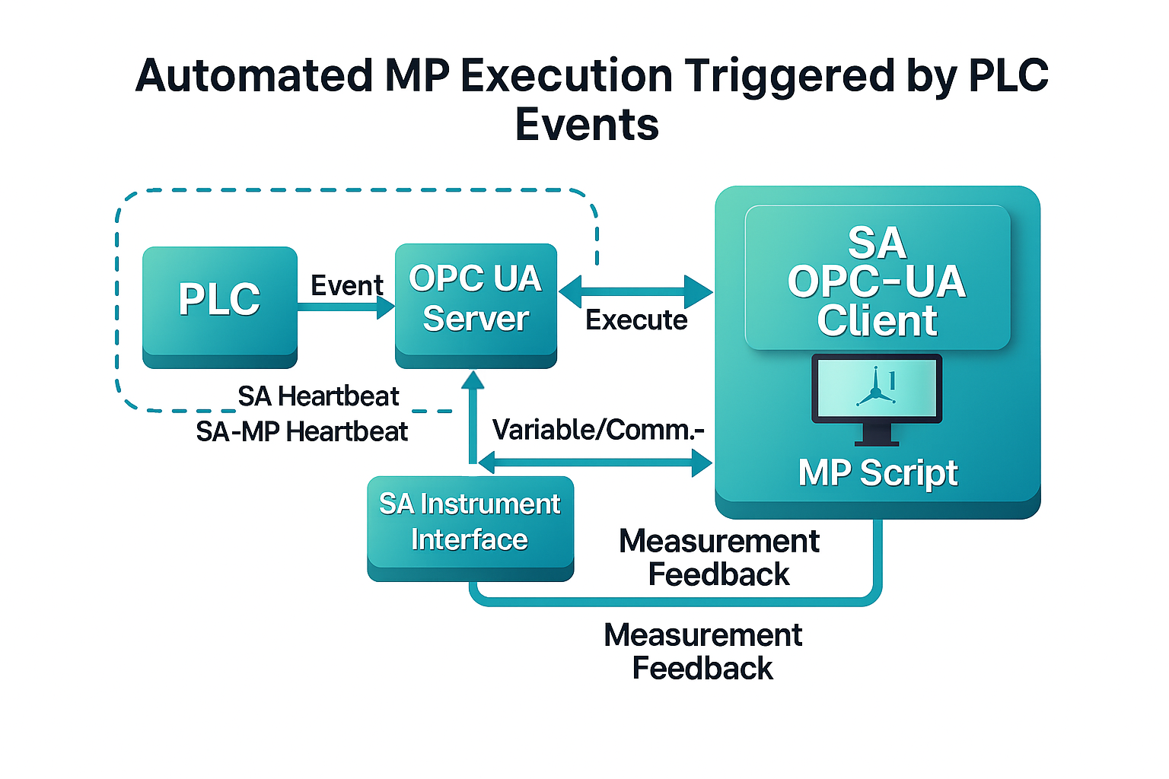
SA OPC UA Overview
Goal: Enable event-driven, automated measurement execution in SA by subscribing to OPC UA tags exposed by shop-floor PLCs or line controllers.
Key Benefits:
Real-time, triggering of measurement plans based on production states (e.g., “part clamped,” “fixture ready,” “position verified”).
Reduced operator interaction, cycle-time, and variability.
Standard, scalable integration aligned with Industry 4.0 architectures.

Slide 4
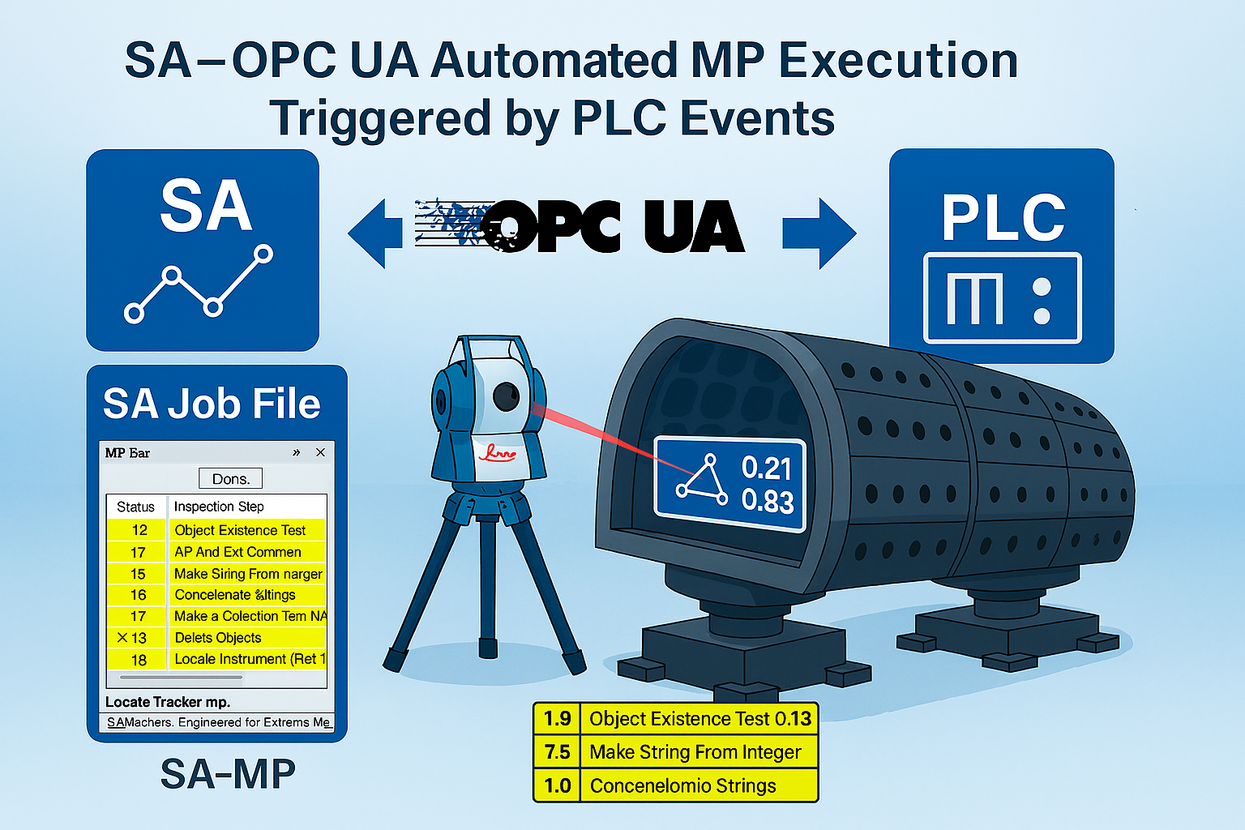
SA – OPC UA Automated MP Execution Triggered by PLC Events
Seamless automation via OPC UA: Standardized protocol lets SA respond to PLC signals without custom middleware, enabling clean, bidirectional communication.
Event‑driven measurement execution: PLC triggers SA MP runs when production conditions are met (e.g., part in position, fixture locked), cutting delays and manual intervention.
Reliable, repeatable, traceable workflows: Automated triggers reduce timing/execution errors, improve repeatability, and produce structured, auditable data for aerospace compliance.
Productivity and scalability: Shorter cycles and higher throughput today, with an architecture that scales to Smart Factory/Industry 4.0 initiatives.

Slide 5
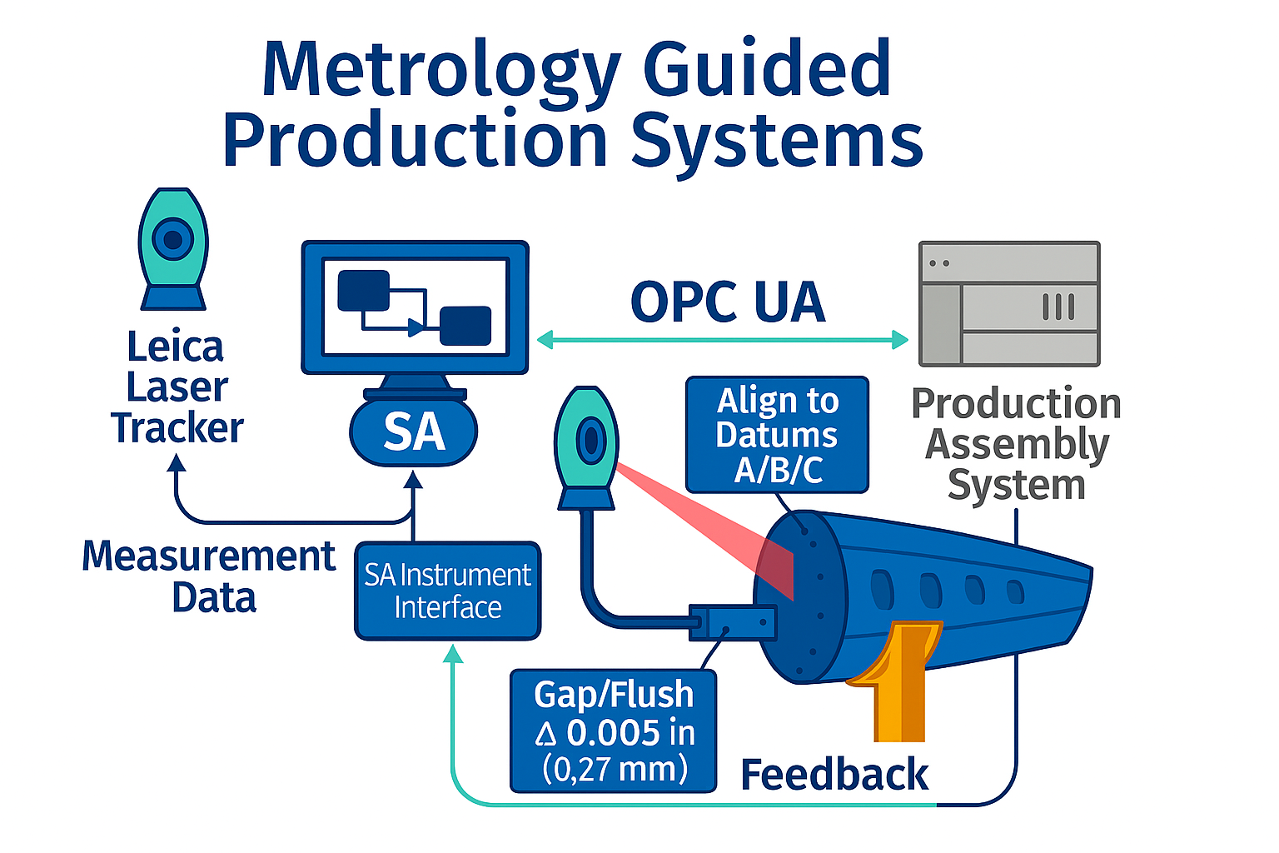
SA OPC UA for Metrology Guided Production Systems
Standardized, secure OPC UA: Interoperable SA ↔ Production data exchange.
Real‑time & event‑driven streaming: Dimensional results and status (coordinates, deviations, tolerances) published during/after MP execution for adaptive decisions.
Traceability & quality control: Production System links data to work orders/serials/station/instrument/operator/time; enables auto‑hold/rework, dashboards/SPC, and aerospace compliance (FAI/AS9102).
Scalable, structured integration: OPC UA info models/semantic tags; bridges ERP and PLC/robot/SCADA; supports multi‑station/multi‑instrument synchronization.

Slide 6
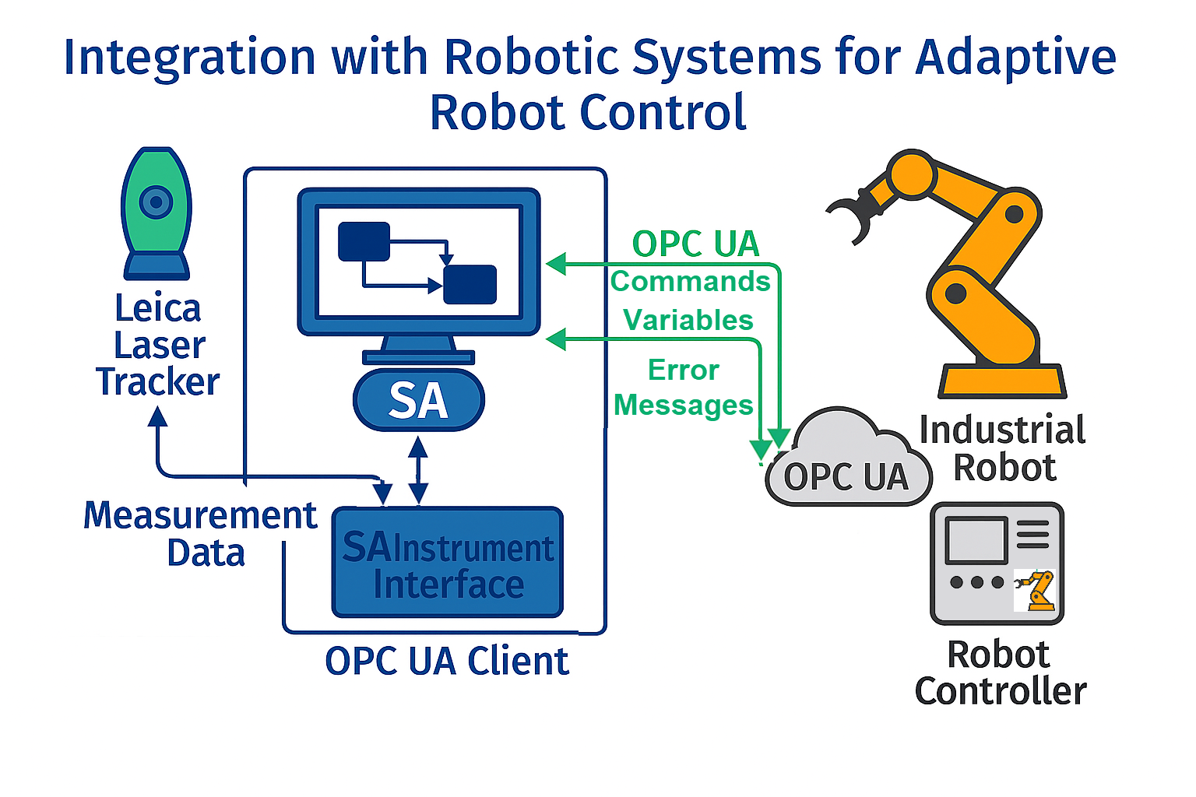
SA OPC UA Integration for Adaptive Robot Control
Real‑time OPC UA communication: SA acts as an OPC UA client—subscribes to robot/PLC tags and publishes measurement feedback for adaptive control.
Event‑driven execution: SA Measurement Plans are triggered by robot states (e.g., Ready for Scan, Move Complete) via OPC UA events.
Closed‑loop, adaptive path control: Live metrology (position/orientation/deviation) drives on‑the‑fly trajectory corrections until tolerance is met.
Standardized data & traceability: Secure, platform‑independent OPC UA integration shares results/status (OK/NG, error codes) for validation and logging.

Slide 7
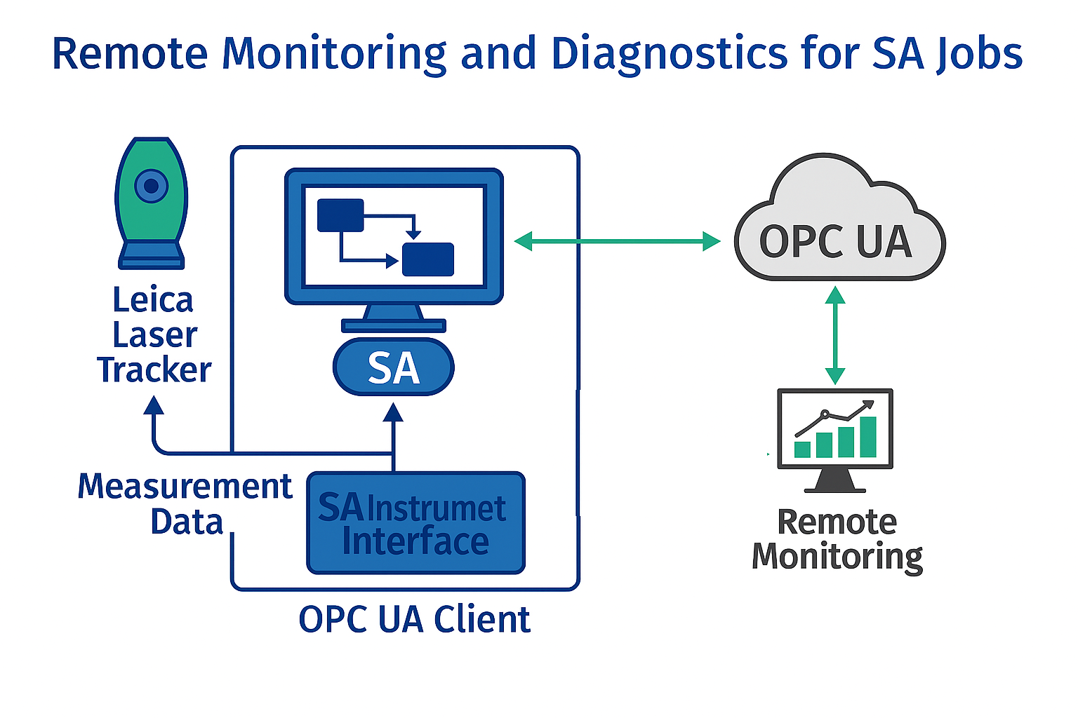
SA OPC UA for Remote Monitoring & Diagnostics
Standardized OPC UA exchange: Secure, interoperable SA ↔ MES connectivity.
Real‑time streaming + events: Publish dimensional results live or on step completion during MP execution to enable adaptive decisions.
Structured, semantic data: OPC UA information models/tags for efficient, auditable MES consumption.
Scalable integration: Supports multi‑station, multi‑instrument cells with synchronized metrology data.

Slide 8
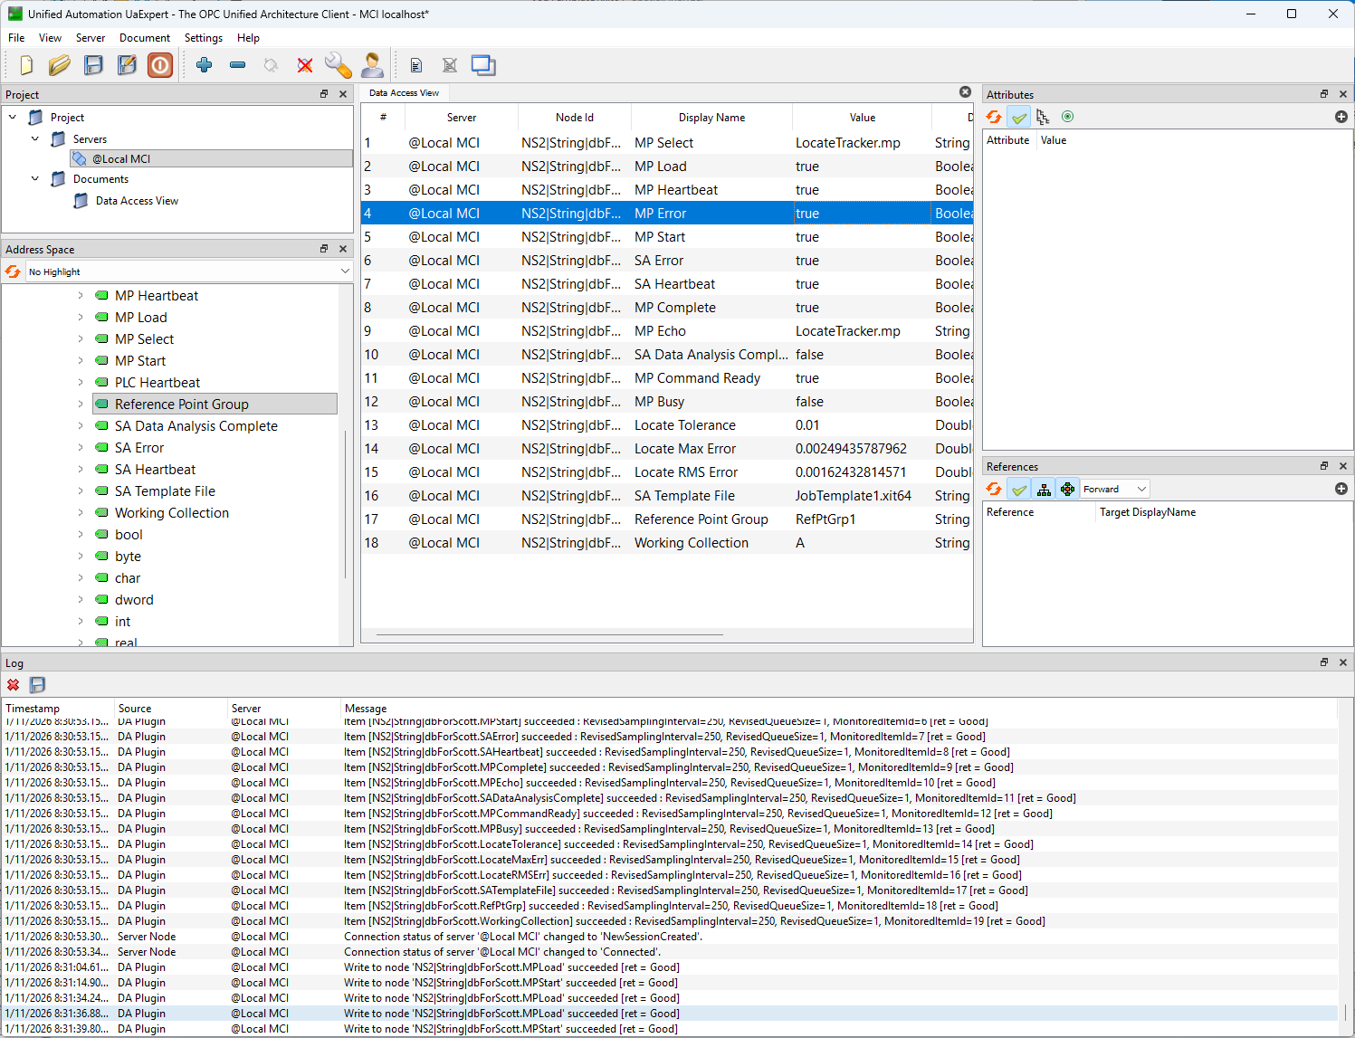
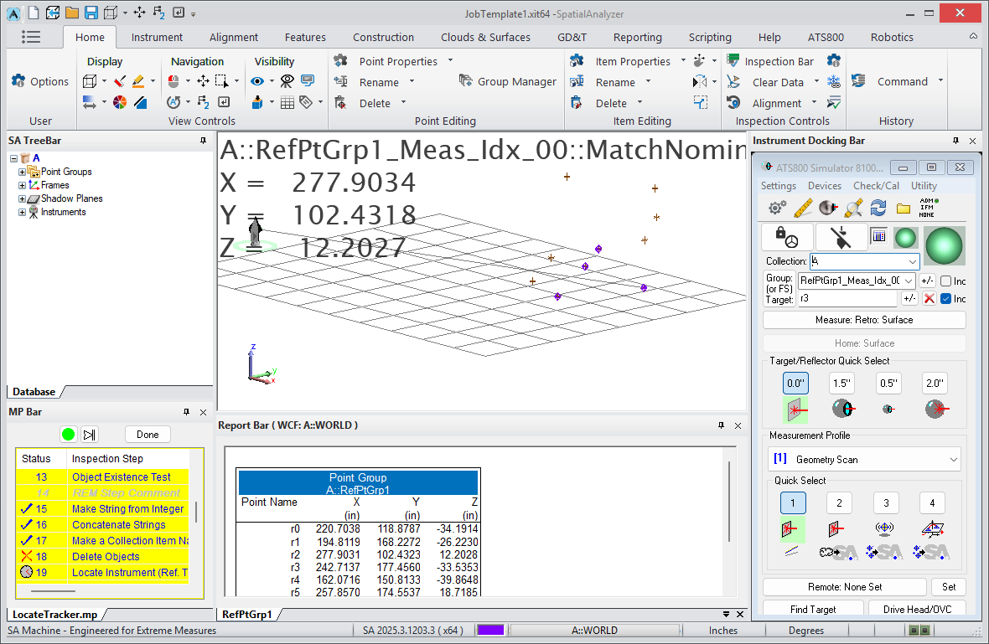
SA OPC UA Demo PLC Commanding and Controlling Robotic Inspection
OPC UA Server
SA OPC UA Client
Commands
Variables
Error Handling

Slide 9
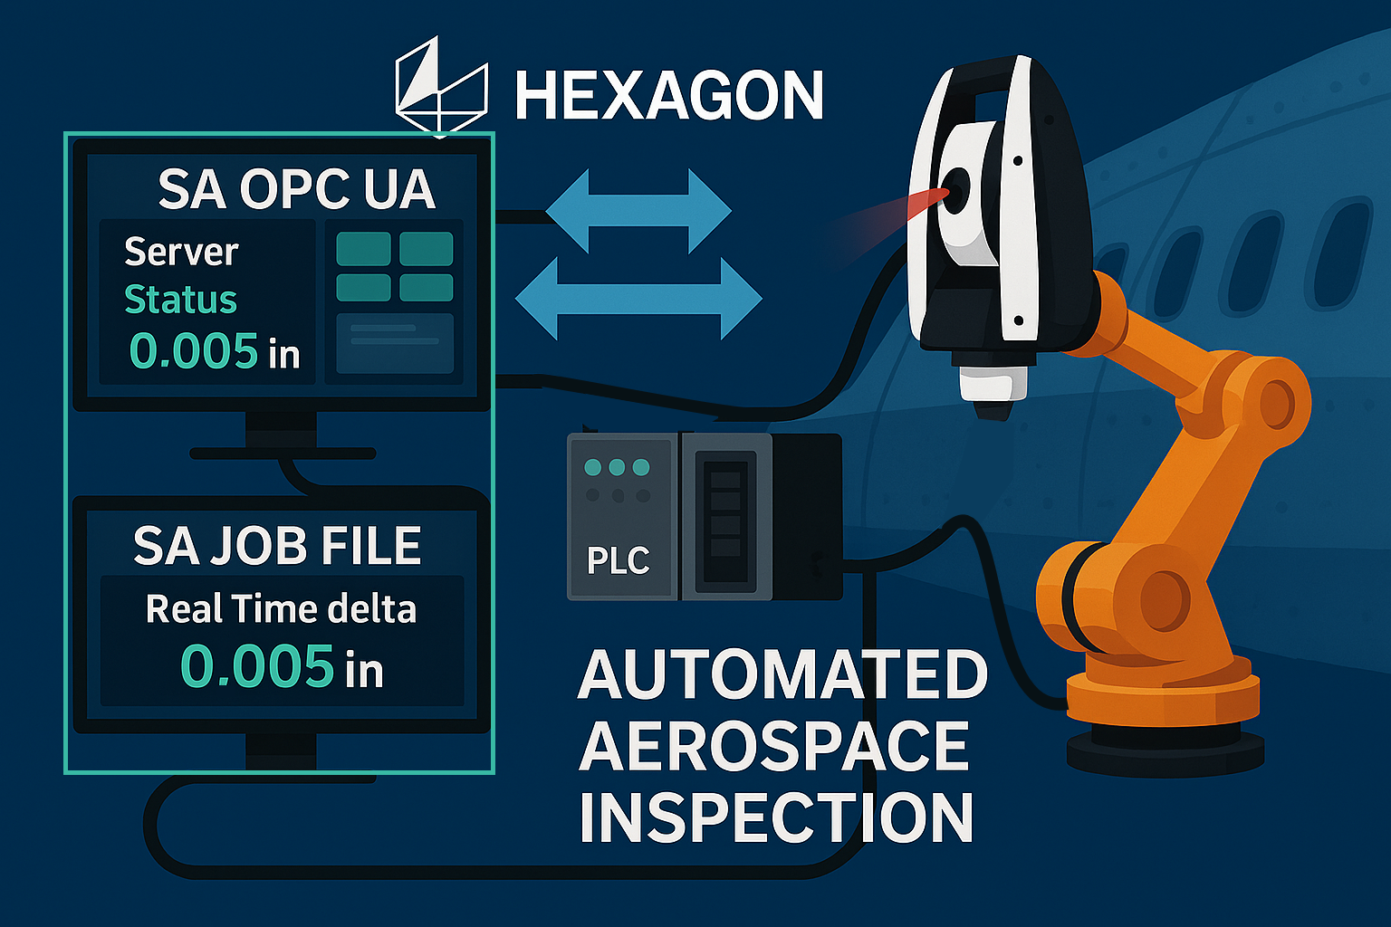
SA OPC UA Solutions

Slide 10
Thank you!

